Slide 1

Business Strategy and HR Strategy Concepts
Unit 1

Slide 2

What is Strategy?
Strategy is a term that refers to a complex web of thoughts, ideas, insights, experiences, goals, expertise, memories, perceptions, and expectations that provides general guidance for specific actions in pursuit of particular ends.

Slide 3

Stages in Strategic Management
Strategic analysis
  Environmental analysis
  Establish organizational direction
Strategy formulation
Strategy implementation
Strategic control

Slide 4

Definition of HRM
HRM can be defined as a strategic and coherent approach to the management of an organization's most valued assets - the people working there who individually and collectively contribute to the achievement of its objectives.

Slide 5

Strategic Human Resource Management Planning Process
Understand Your Business Goals
Evaluate Your Team
Analyze Your HR Capabilities
Examine Each Department
Begin Hiring To Satisfy Departmental Needs

Slide 6

HRM – Changing Times?
Views of employees as cost center is changing
Selection process
Induction and training process
Education
Retention
Compensation
Innovation and learning

Slide 7

VERSIONS OF HRM
Hard HRM
Soft HRM

Slide 8
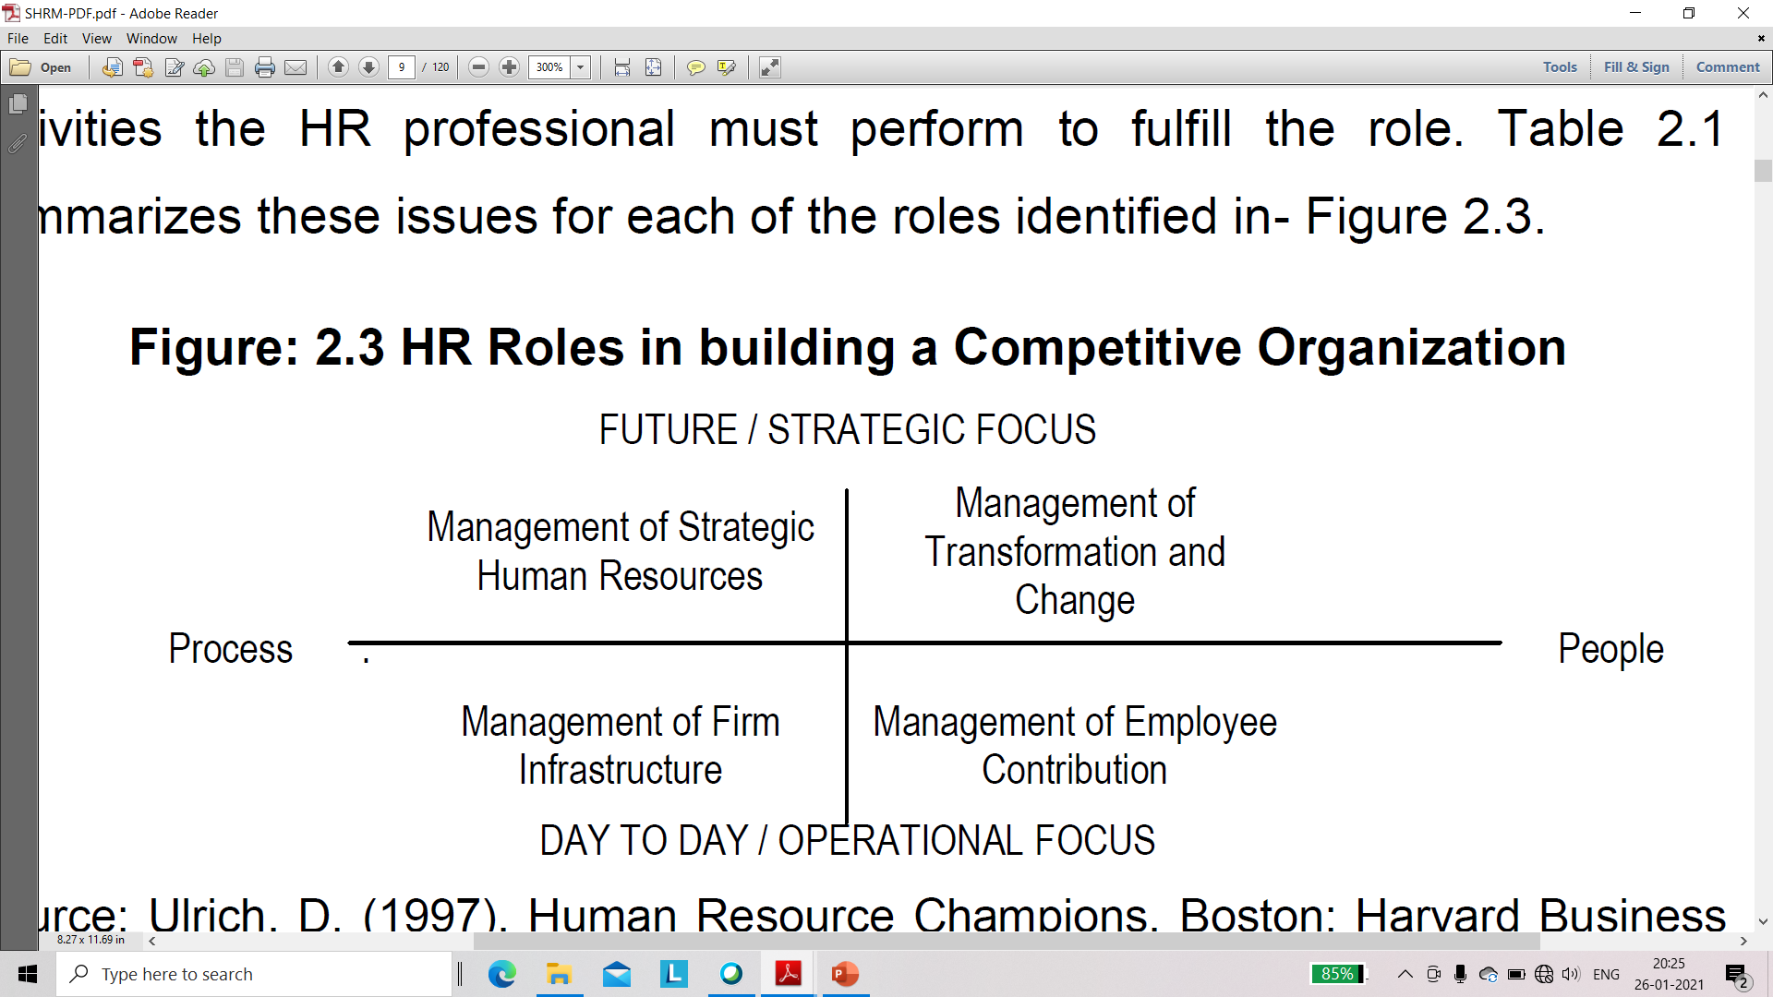
HR Roles in Building a Competitive Organization

Slide 9
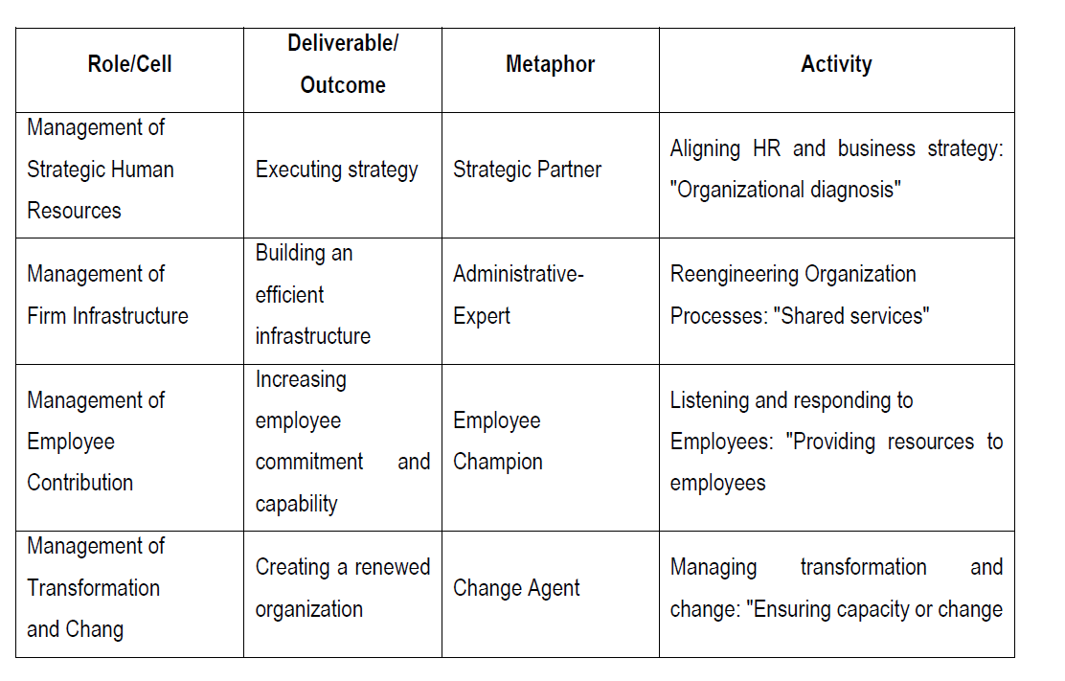

Slide 10

Strategic Human Resource Management
Strategic human resource management can be defined as the linking of human resources with strategic goals and objectives in order to improve business performance and develop organizational culture that foster innovation, flexibility and competitive advantage. In an organisation SHRM means accepting and involving the HR function as a strategic partner in the formulation and implementation of the company's strategies through HR activities such as recruiting, selecting, training and rewarding personnel.

Slide 11
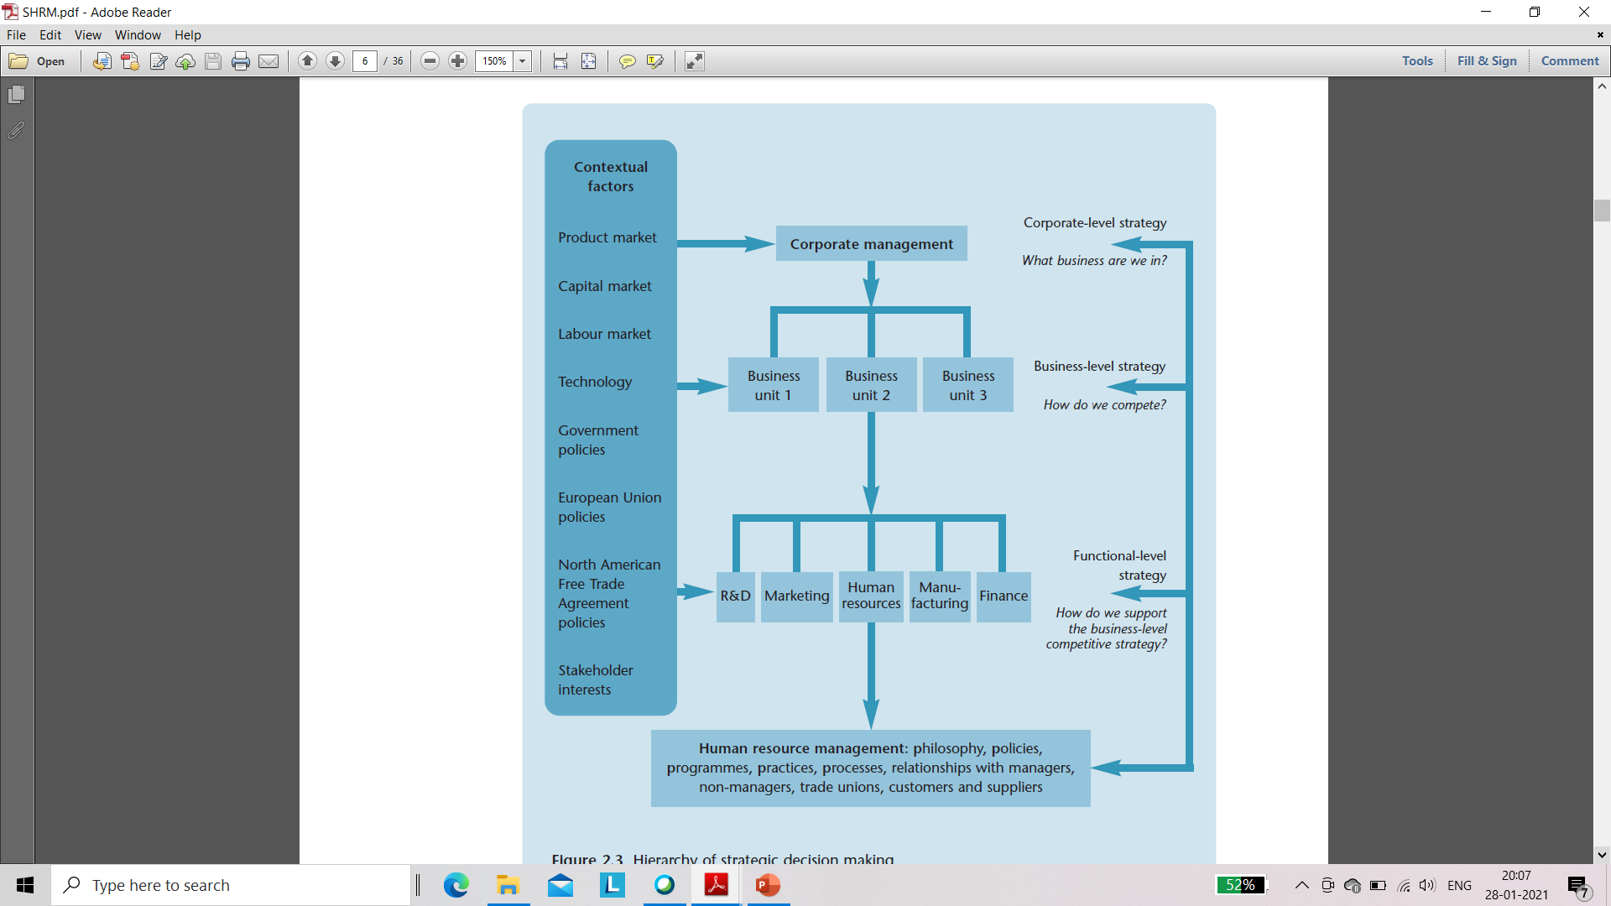
Hierarchy of Strategic Decision Making

Slide 12

HRM - Overall Strategic Plan of the Organization
Staffing
Basic Workplace Policies
Compensation and Benefits
Retention
Training and Development
Regulatory Issues and Worker Safety

Slide 13
Concept of Integration of SHRM Has Three Aspects
The linking of HR policies and practices with the strategic management process of the organization
The internalization of the importance of HR on the part of line managers
The integration of the workforce into the organization to foster commitment or an ‘identity of interest’ with the strategic goals.

Slide 14
Concept of Global Strategic Management
The mixed set of economies
Diverse talent pool
Bigger and better competitors
Technology and digitization wave
Process efficiencies
Cost-effectiveness

Slide 15

Newly Revised Model - Areas of HR
Strategic partner
Change agent
Administrative expert and functional expert
Human capital developer
Employee advocate

Slide 16

HRM as a Strategic Component of the Business
Make it applicable
Be a strategic partner
Involve people
Understand how technology can be used

Slide 17

CONTENTS
Downsizing
Rightsizing
Smart Sizing
Sabbatical

Slide 18

What is Rightsizing in an Organization?
Rightsizing is the process of a company restructuring or reorganizing itself by reducing its workforce, cost-cutting, or rearranging its upper management. Technically, the term means adapting the company to market conditions, which in theory could also mean increasing the workforce.

Slide 19
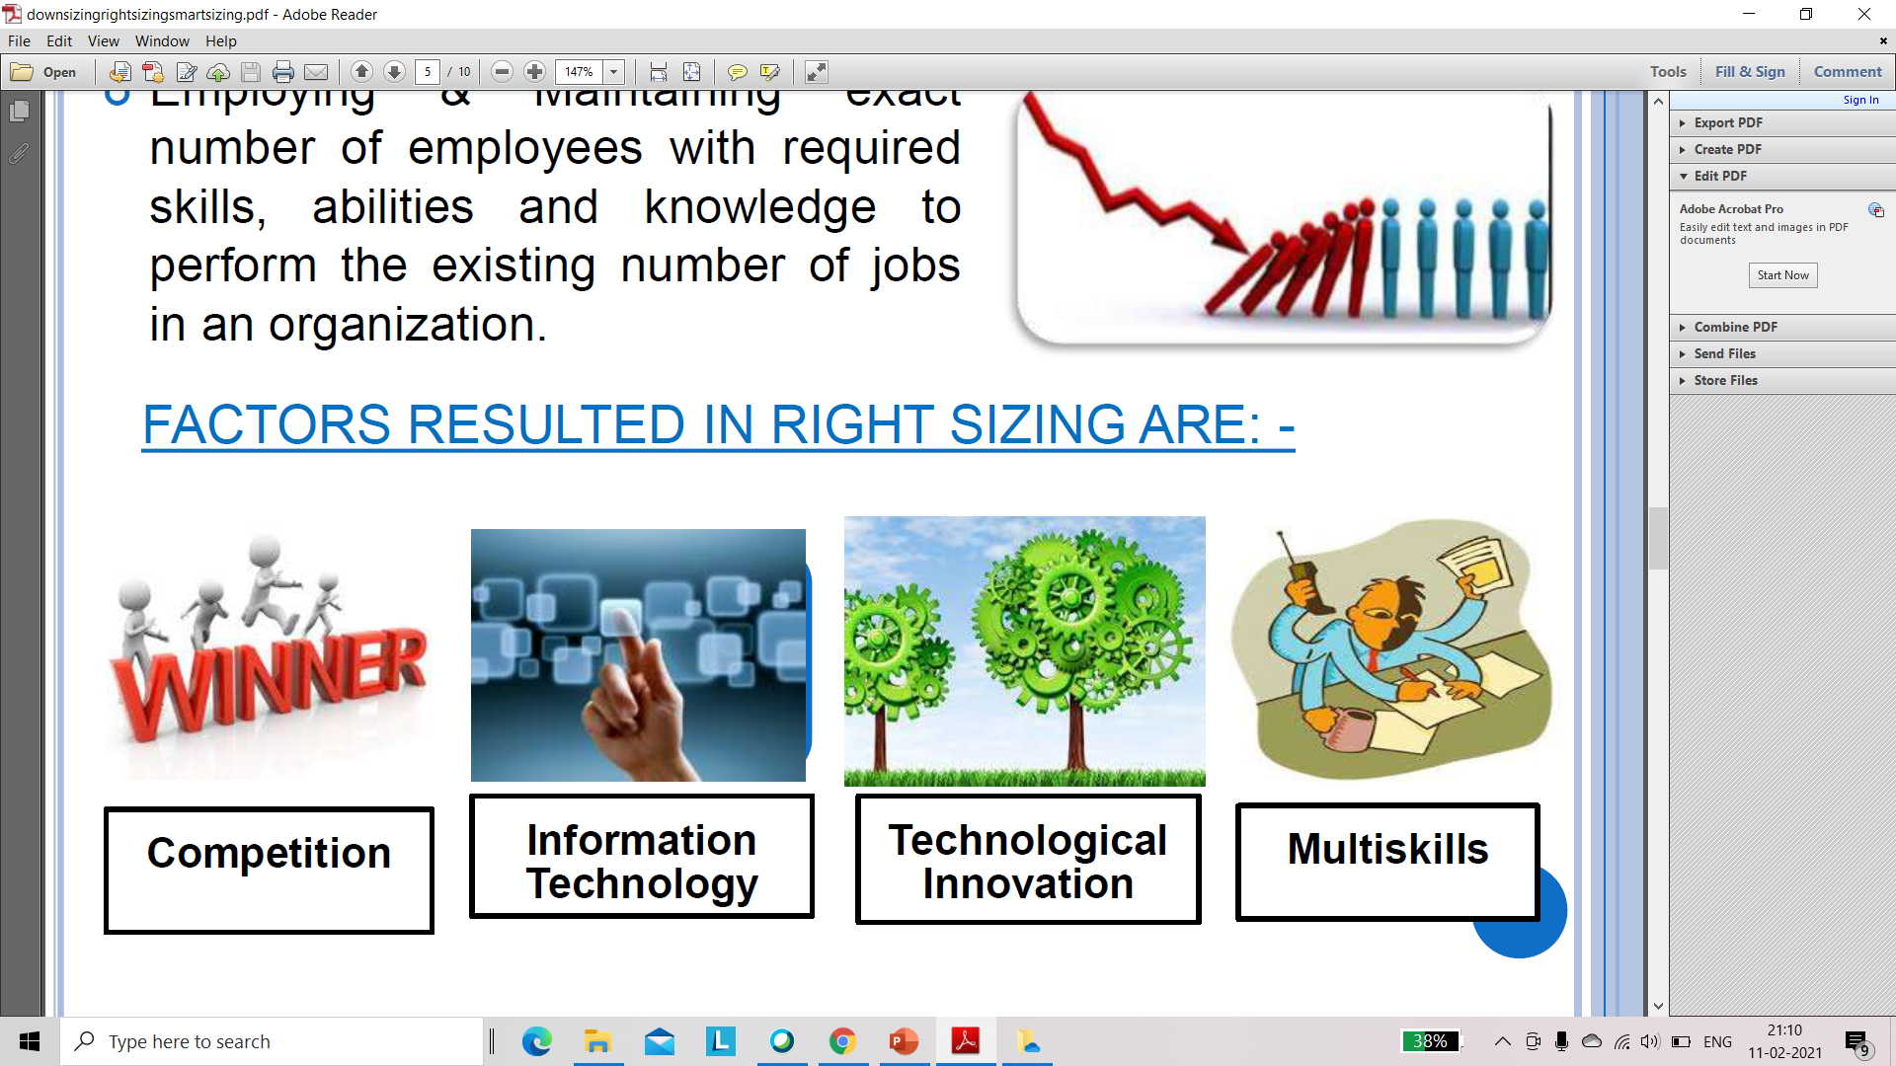
Factors Resulted in Right Sizing

Slide 20
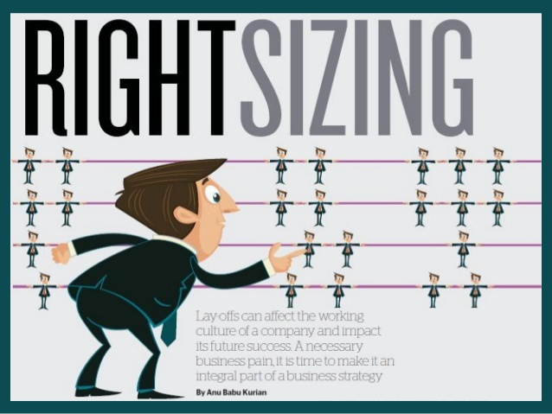
Need For Rightsizing
○ To have exact number of employees as per the
   job analysis,
   job description and
   job specification exercise of the company.
○ To reduce dysfunctional activities of employees.
○ To minimize the cost of human resources and to
increase the production cost by eliminating
unnecessary costs.
○ To reduce maintenance activities of various
employees facilities and benefits like housing,
canteen, transportation, medical and recreation.
○ To maximize productivity by enhancing employee
performance.
○ To avoid formation of trade union
and it’s consequences.

Slide 21

What is Downsizing in HRM?
Downsizing refers to the process of reducing the size of workforce by terminating the employment of employees. It is also referred as layoff.
Downsizing not only affects the employees who have to exit the company, but also the remaining employees who may fear themselves to be in a similar situation at a later time.

Slide 22
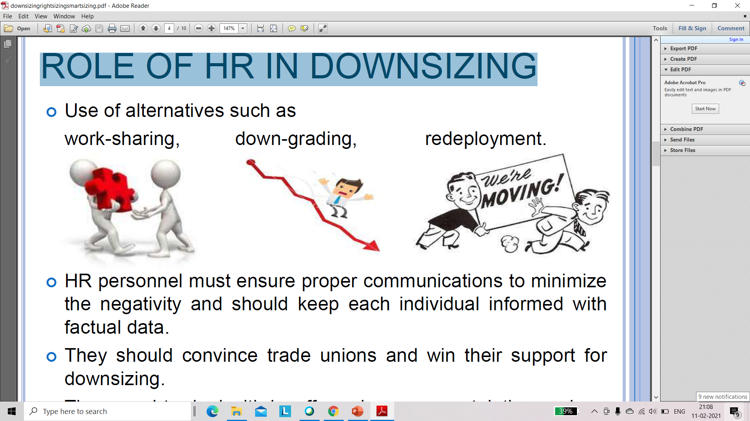
Role of HR in Downsizing

Slide 23
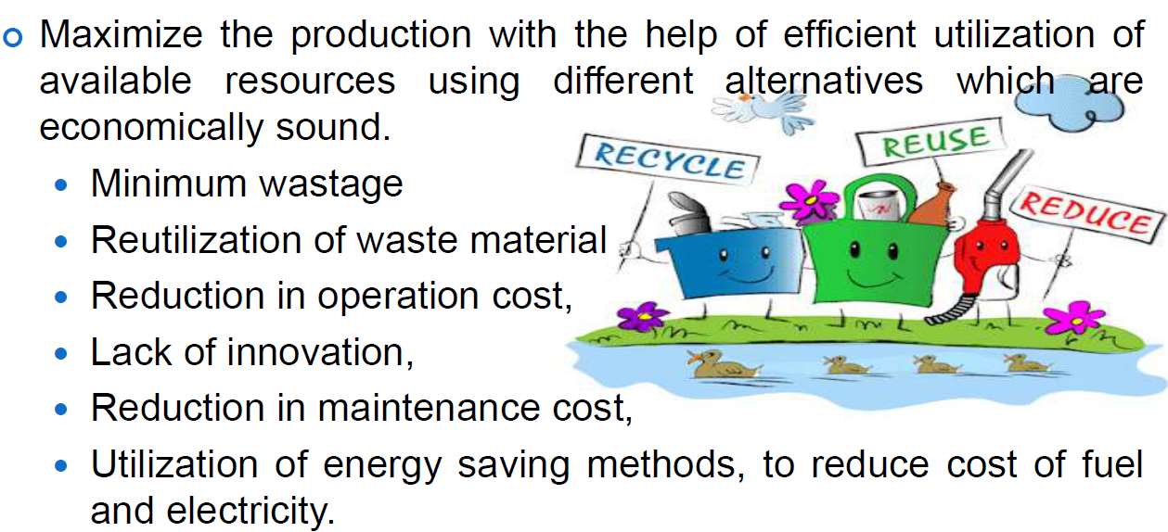
SMART SIZING

Slide 24

Extended leave of absence granted to employees for renewal purpose.
Offer 4 to 6 months service leaves that allows manager and executives to perform special service with nonprofit organizations.

Slide 25

BENEFITS
COMPANIES
INDIVIDUAL
○ Retain Valued Employees
○ Attract Top Talent
○ Increase Productivity
○ Develop High Potentials
○ Revitalize Your Workforce
○ Get Great Public Relations
○ Self-Awareness
○ Replenished Energy
○ Renewed Commitment
○ A Surge of Creativity
○ The Ability to Inspire
○ Increased Confidence

Slide 26

Recession
According to National Bureau of Economic Research,
Recession as a “significant decline in economic activity lasting more than a few months.”

Slide 27

HRM Innovations in Recession
To optimize the manpower strength
Reduce the number of employees in the organization
To take strategic initiatives to increase the productivity and efficiency of the entire organization.
To work on compensation benefits
Cancellation of several benefit schemes
Redesign training and development programs
To identify the real key employees and to intact them in the organization
To identify the real top potentials and to strengthen their development program

Slide 28

HRM Role after Recession
1. The HRM Function has to be able to identify the top potential in the organization quickly as the company needs to make the cuts in the human capital of the organization.
2. The HRM Function needs to provide the tools to managers to inform their key employees about the security, the company wants to offer to key employees.
3. The HRM Function is not a department to make employees happy, the role of HRM Function is also about the cuts in the costs of the organization .
4. HRM Function’s role is about minimizing the damages to the organization.
5. The HRM Management has to define the HRM Vision for the Recession.

